Slide 1
Java Servlets
By Michael Crump

Slide 2
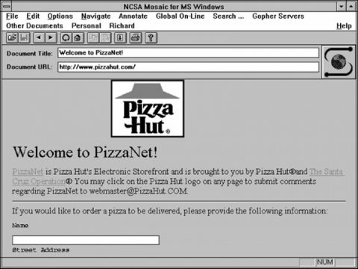
Background
In the early days of the Internet, applets were the first solution to services requiring dynamic content. Applets focused on using the client platform for these experiences. People also tried using the server platform, mainly through Common Gateway Interface (CGI) scripts. Both worked, but both had their limitations. The CGI technology, particularly, had a strong dependence on the platform, and it wasn’t too good at scalability. Java servlets were created to provide better dynamic, portable, user-oriented content.

Slide 3
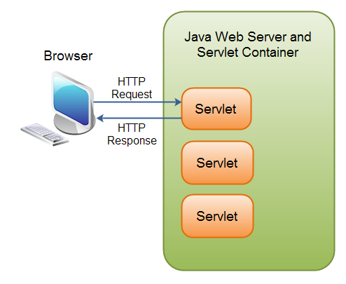
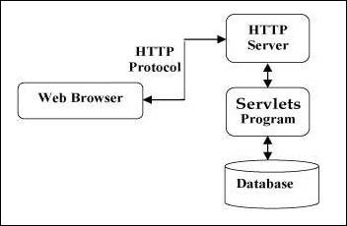
What is a Servlet?
A Java servlet is a Java program that extends the capabilities of a server.
They are programs that run on a Web or Application server and act as a middle layer between a request coming from a Web browser or other HTTP client, and databases or applications on the HTTP server.
Among other things, they can be used to collect input through forms, to display records from a database, or to create web pages dynamically.

Slide 4
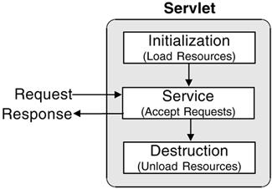
Lifecycle of a Servlet
There are three stages in the life cycle of a servlet: init(), service(), and destroy(). These stages are implemented by every servlet and are invoked at specific times by the server. The lifecycle of a servlet is controlled by the container in which the servlet has been deployed.
During the initialization stage, the web container initializes the servlet instance by calling the init() method, and passes an object which implements the java.servlet.ServletConfig interface. This configuration object allows the servlet to access name-value initialization parameters from the web application.
After initialization, the servlet instance can service client requests. Each request is serviced in its own separate thread. The web container calls the service() method of the servlet for every request. The service() method determines the kind of request being made and dispatches it to an appropriate method to handle the request. The developer of the servlet must provide an implementation for these methods. If a request is made for a method that is not implemented by the servlet, the method of the parent class is called, typically resulting in an error being returned to the requester.
Finally, the web container calls the destroy() method that takes the servlet out of service. The destroy() method, like init(), is called only once in the lifecycle of a servlet.

Slide 5
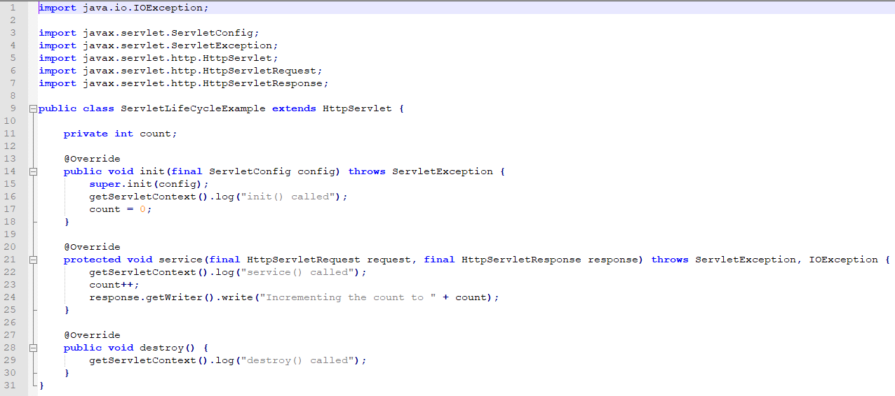
Servlet in Action

Slide 6
References
https://www.tutorialspoint.com/servlets/servlets_overview.htm
https://docs.oracle.com/javaee/6/tutorial/doc/bnafi.html
https://en.wikipedia.org/wiki/Java_servlet

